Slide 1



DATA ANALYTICS
Consumer Goods
Ad-Hoc Insights
10 data-driven SQL requests to power faster
and smarter business decisions at AtliQ Hardwares
AtliQ Hardwares · Consumer Goods Division · Designed by – Chirag Pacheria

Slide 2




COMPANY OVERVIEW
26+
74
6
3
4
Countries
Customers
Segments
Channels
Regions
Operates across APAC, EU, North America (NA), and Latin America (LATAM)
Products: Peripherals · Accessories · Notebooks · Desktops · Storage · Networking
Channels: Direct · Distributor · Retailer (brick-and-mortar + e-commerce)
AtliQ Hardwares · Consumer Goods Division · Designed by – Chirag Pacheria

Slide 3
OBJECTIVE
OBJECTIVE
To address management's need for better insights by developing 10 ad-hoc SQL requests that support quick and smart data-informed decision-making.
10
Speed
Faster decisions with ready data
AD-HOC REQUESTS
Clarity
Clean, structured ad-hoc answers
Impact
Drive revenue & efficiency gains
AtliQ Hardwares · Consumer Goods Division · Designed by – Chirag Pacheria

Slide 4
ABOUT THE DATA
DIMENSION TABLES
FACT TABLES
dim_product
fact_gross_price
Detailed product info & segments
Gross price for each product
dim_customer
fact_manufacturing_cost
Customer details, market, region & channel
Production cost per product
fact_pre_invoice_deductions
Pre-invoice deduction details
fact_sales_monthly
Monthly sales — FY2020 & FY2021
Fiscal Year: Sep 1 – Aug 31 · Data covers FY 2020 and FY 2021

Slide 5
INSIGHTS
Let's dive into
10 Key Ad-Hoc Requests
SQL queries delivering critical business insights from management

Slide 6
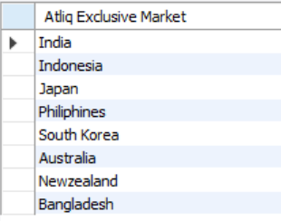
Atliq Exclusive markets in the APAC region
SQL
APAC Markets
SELECT DISTINCT(Market) AS 'Atliq Exclusive Market'
FROM dim_customer
WHERE customer = 'Atliq Exclusive'
AND REGION = 'APAC';
1
REQ
KEY FINDING
Atliq Exclusive operates in 8 countries across the APAC region:
India · Indonesia · Japan · Philippines · South Korea · Australia · New Zealand · Bangladesh
AtliQ Hardwares · Consumer Goods Division · Designed by – Chirag Pacheria

Slide 7
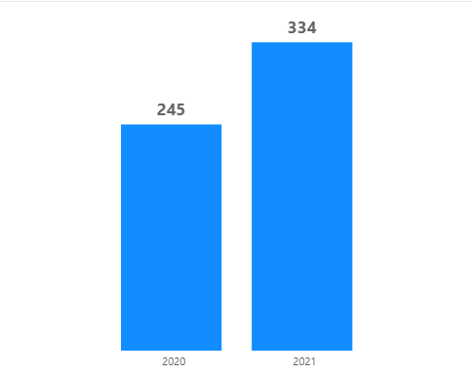
Percentage of unique product increase in 2021 vs. 2020
SQL
Unique Products
WITH CTE AS (
SELECT
COUNT(DISTINCT CASE WHEN fiscal_year=2020 THEN product_code END) AS Unique_2020,
COUNT(DISTINCT CASE WHEN fiscal_year=2021 THEN product_code END) AS Unique_2021
FROM fact_sales_monthly
)
SELECT Unique_2020, Unique_2021,
ROUND((Unique_2021-Unique_2020)*100/Unique_2020,2) AS Percent_change
FROM CTE;
2
REQ
245
334
36%
Products 2020
Products 2021
Increase
KEY FINDING
A 36% increase in unique products was recorded from 2020 (245 products) to 2021 (334 products).
AtliQ Hardwares · Consumer Goods Division · Designed by – Chirag Pacheria

Slide 8
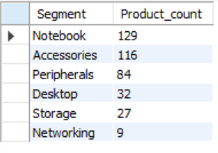
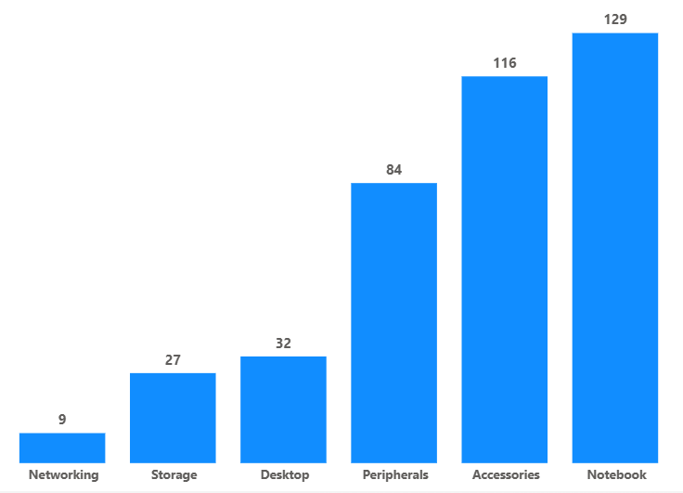
Unique product counts for each segment
SQL
Segment Product Count
SELECT Segment,
COUNT(DISTINCT product_code) AS Product_count
FROM dim_product
GROUP BY Segment
ORDER BY Product_count DESC;
3
Product Count by Segment
REQ
KEY FINDING
Notebook (129), Accessories (116), and Peripherals (84) feature the most extensive product ranges at AtliQ Hardwares.
AtliQ Hardwares · Consumer Goods Division · Designed by – Chirag Pacheria

Slide 9
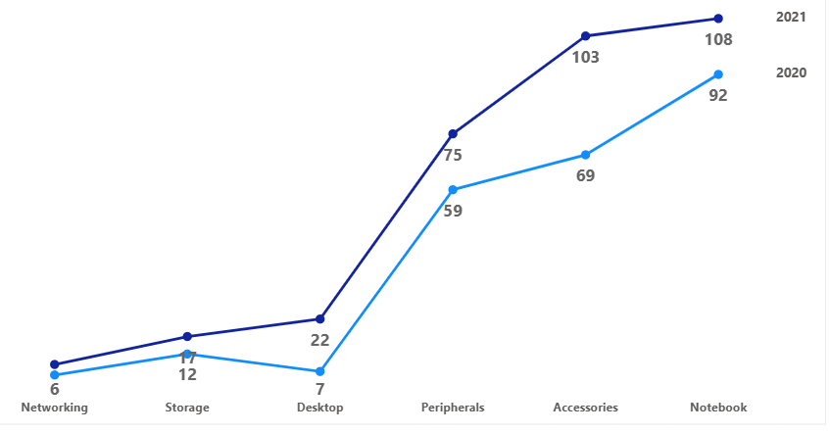
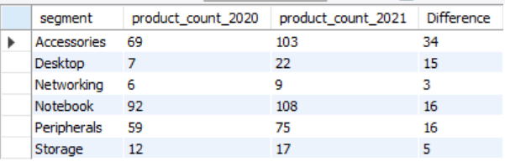
Segment with the most increase in unique products (2021 vs. 2020)
SQL
Products 2020 vs 2021 by Segment
WITH CTE AS (
SELECT y.segment,
COUNT(DISTINCT CASE WHEN x.fiscal_year=2020 THEN x.product_code END) AS count_2020,
COUNT(DISTINCT CASE WHEN x.fiscal_year=2021 THEN x.product_code END) AS count_2021
FROM fact_sales_monthly x
JOIN dim_product y USING(product_code)
GROUP BY y.segment
)
SELECT *, count_2021 - count_2020 AS Difference FROM CTE;
4
REQ
Segment Difference Table
KEY FINDING
With 34 new products added, the Accessories segment leads all divisions in product introductions from 2020 to 2021.
AtliQ Hardwares · Consumer Goods Division · Designed by – Chirag Pacheria

Slide 10
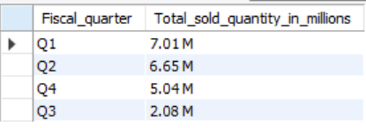
Products with highest and lowest manufacturing costs
SQL
Manufacturing Cost Result
WITH CTE AS (
(SELECT product_code, AVG(manufacturing_cost) AS cost
FROM fact_manufacturing_cost GROUP BY product_code ORDER BY cost DESC LIMIT 1)
UNION
(SELECT product_code, AVG(manufacturing_cost) AS cost
FROM fact_manufacturing_cost GROUP BY product_code ORDER BY cost ASC LIMIT 1)
)
SELECT x.product_code, CONCAT('$ ',ROUND(cost,2)) AS Cost, y.product
FROM CTE x JOIN dim_product y USING(product_code) ORDER BY cost DESC;
5
REQ
Highest Cost
Lowest Cost
$241.00
$0.91
AQ HOME Allin 1 Gen 2
AQ Master wired x1 Ms
KEY FINDING
AQ HOME Allin 1 Gen 2 is the most expensive at $241. AQ Master wired x1 Ms is most cost-efficient at $0.91. Prioritizing efficiency in high-cost products will strengthen competitive position.
AtliQ Hardwares · Consumer Goods Division · Designed by – Chirag Pacheria l

Slide 11
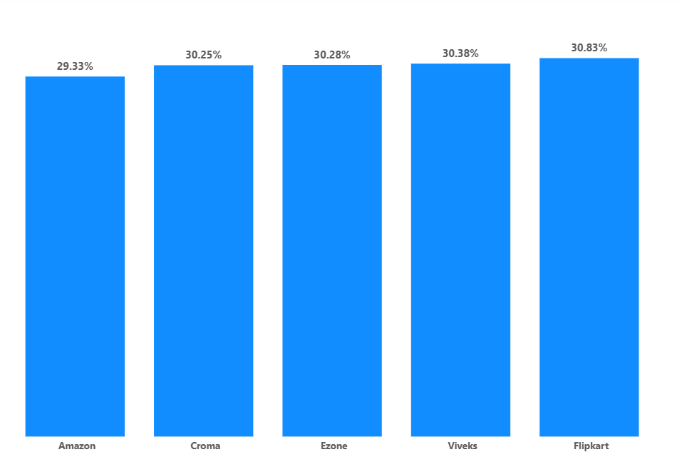
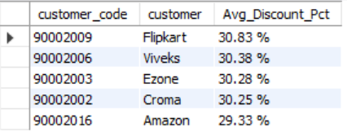
Top 5 customers with highest avg pre-invoice discount — India, FY2021
SQL
Avg Pre-Invoice Discount %
WITH CTE AS (
SELECT customer_code, AVG(pre_invoice_discount_pct) AS Avg_discount_pct
FROM fact_pre_invoice_deductions WHERE fiscal_year=2021
GROUP BY customer_code ORDER BY Avg_discount_pct DESC
)
SELECT x.customer_code, y.customer,
CONCAT(ROUND(x.Avg_discount_pct*100,2),' %') AS Avg_Discount_Pct
FROM CTE x JOIN dim_customer y USING(customer_code)
WHERE market='India'
ORDER BY x.Avg_discount_pct DESC LIMIT 5;
6
REQ
Top 5 Customers — India
KEY FINDING
Flipkart (30.83%), Viveks (30.38%), Ezone (30.28%), Croma (30.25%), and Amazon (29.33%) receive the highest pre-invoice discounts — averaging nearly 30% off gross price.
AtliQ Hardwares · Consumer Goods Division · Designed by – Chirag Pacheria

Slide 12
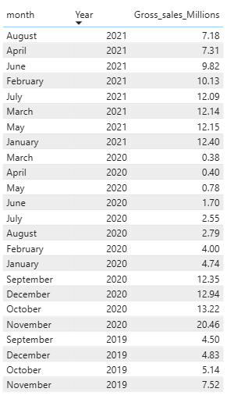
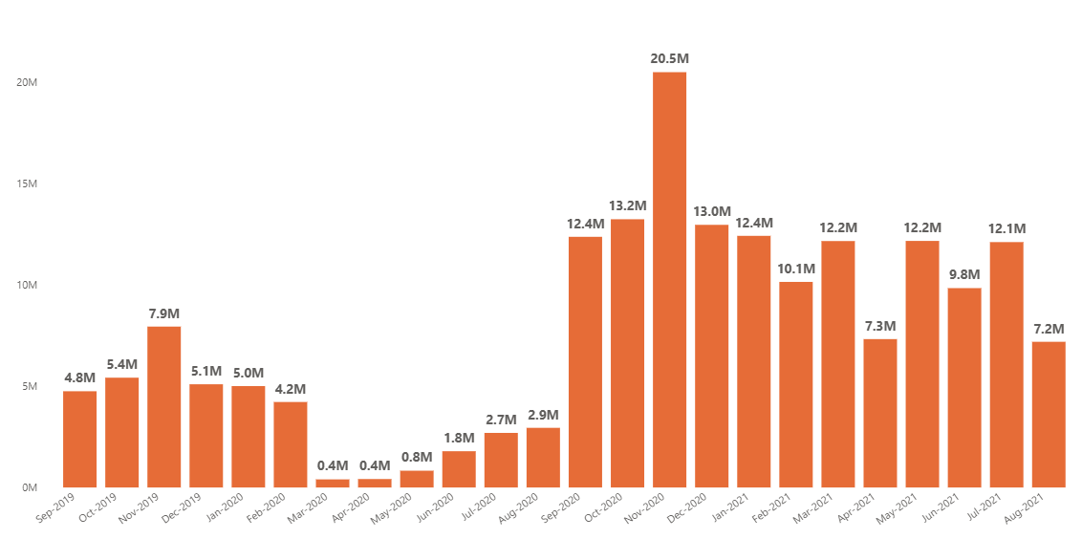
Gross sales amount for 'Atliq Exclusive' by month
SQL
Monthly Gross Sales (M)
SELECT YEAR(date) AS Year, MONTHNAME(date) AS Month,
ROUND(SUM(sold_quantity*gross_price)/1000000,2) AS Gross_sales_Millions
FROM fact_sales_monthly F
JOIN fact_gross_price G
ON F.product_code=G.product_code AND F.fiscal_year=G.fiscal_year
JOIN dim_customer D USING(customer_code)
WHERE customer='Atliq Exclusive'
GROUP BY Year, Month ORDER BY Year;
7
REQ
Monthly Gross Sales — Atliq Exclusive
AtliQ Hardwares · Consumer Goods Division · Designed by – Chirag Pacheria

Slide 13
Gross Sales Insight — Atliq Exclusive Monthly Trend
Monthly Gross Sales in Millions — FY2019 to FY2021
7
REQ
KEY FINDING
Following the lowest sales in FY2020 Q3 (Mar–May 2020), Atliq Exclusive saw a substantial surge in gross sales in FY2021 Q1, peaking at 20.5M in November 2020.
AtliQ Hardwares · Consumer Goods Division · Designed by – Chirag Pacheria

Slide 14
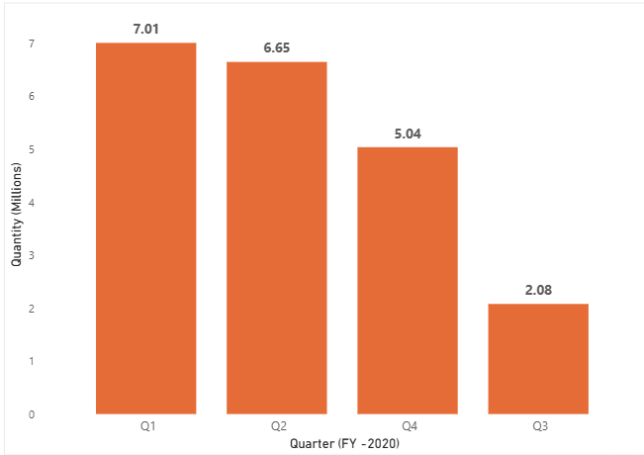
Which quarter of FY2020 had the maximum total sold quantity?
SQL
FY2020 Quarterly Sold Quantity (M)
SELECT
CASE
WHEN MONTH(DATE_ADD(date,INTERVAL 4 MONTH)) IN (1,2,3) THEN 'Q1'
WHEN MONTH(DATE_ADD(date,INTERVAL 4 MONTH)) IN (4,5,6) THEN 'Q2'
WHEN MONTH(DATE_ADD(date,INTERVAL 4 MONTH)) IN (7,8,9) THEN 'Q3'
ELSE 'Q4'
END AS Fiscal_quarter,
ROUND(SUM(sold_quantity)/1000000,2) AS Total_sold_qty_millions
FROM fact_sales_monthly
WHERE fiscal_year=2020
GROUP BY Fiscal_quarter ORDER BY Total_sold_qty_millions DESC;
8
REQ
Q1
Q2
Q4
Q3
7.01M
6.65M
5.04M
2.08M
KEY FINDING
FY2020 started strong with Q1 leading at 7.01M units sold. Q2 saw a slight decline to 6.65M, Q4 dropped to 5.04M, and Q3 recorded the lowest at just 2.08M units — a steep decline likely due to COVID-19 impact.
AtliQ Hardwares · Consumer Goods Division · Designed by – Chirag Pacheria

Slide 15
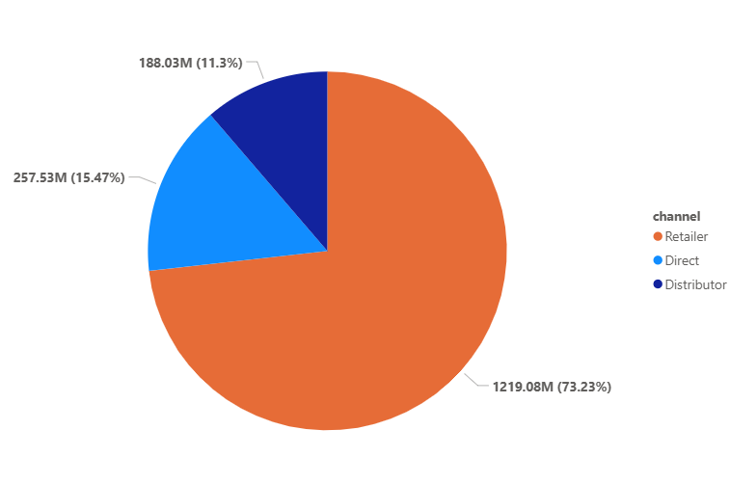
Which channel drove the most gross sales in FY2021?
SQL
Channel Revenue Share FY2021
WITH CTE AS (
SELECT customer_code, SUM(sold_quantity*gross_price) AS Gross_sales, F.fiscal_year
FROM fact_sales_monthly F JOIN fact_gross_price G
ON F.product_code=G.product_code AND F.fiscal_year=G.fiscal_year
GROUP BY customer_code, F.fiscal_year
), CTE_Channel AS (
SELECT D.channel, CONCAT(ROUND(SUM(C.Gross_sales)/1000000,2),' M') AS Gross_sales_M
FROM CTE C JOIN dim_customer D USING(customer_code)
WHERE C.fiscal_year=2021 GROUP BY D.channel
)
SELECT *, CONCAT(ROUND(Gross_sales_M*100/(SELECT SUM(Gross_sales_M) FROM CTE_Channel),2),' %') AS Percentage
FROM CTE_Channel ORDER BY Percentage DESC;
9
REQ
Retailer
Direct
Distributor
$1,219.08M
$257.53M
$188.03M
73.23%
15.47%
11.3%
KEY FINDING
The Retailer channel was the primary revenue driver in FY2021, contributing 73.23% of total gross sales — generating $1,219.08M. Direct followed at $257.53M (15.47%) and Distributor at $188.03M (11.3%).
AtliQ Hardwares · Consumer Goods Division · Designed by – Chirag Pacheria

Slide 16
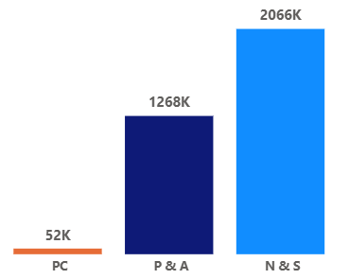
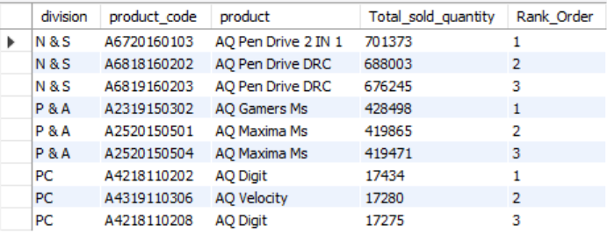
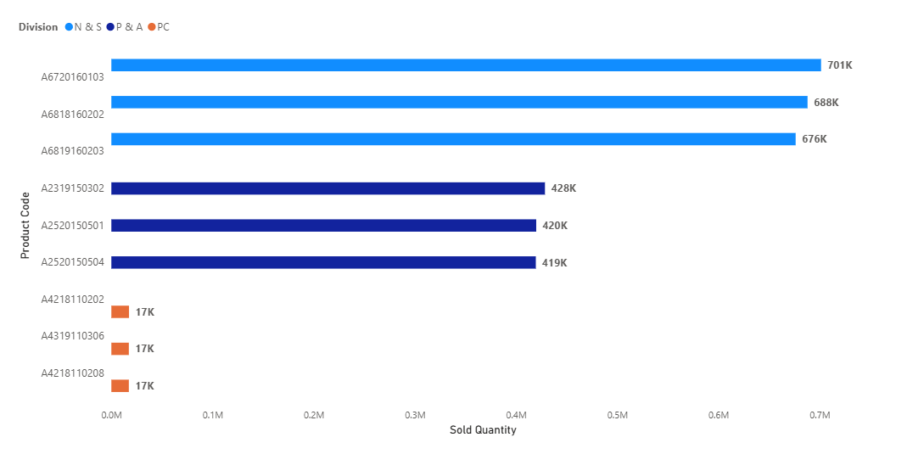
Top 3 products per division by total sold quantity — FY2021
SQL
Division Total Sold Qty
WITH CTE AS (
SELECT c.division, f.product_code, c.product,
SUM(sold_quantity) AS Total_sold_qty,
DENSE_RANK() OVER (PARTITION BY division ORDER BY SUM(sold_quantity) DESC) AS Rank_Order
FROM fact_sales_monthly f JOIN dim_product c USING(product_code)
WHERE f.fiscal_year=2021
GROUP BY c.division, f.product_code, c.product
)
SELECT * FROM CTE WHERE Rank_Order <= 3;
10
REQ
Top 3 Products per Division
Top 3 Products Bar
N&S = Network & Storage · P&A = Peripherals & Accessories · PC = Notebook & Desktop

Slide 17

THANK
YOU
CONCLUSION
To conclude, this project helped to analyze product growth, customer discounts, sales trends and sales channels.
AtliQ Hardwares · Consumer Goods Division

